Slide 1
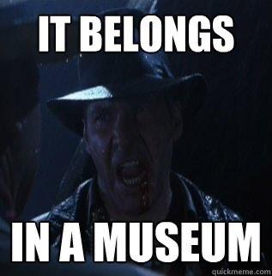
Machine learning belongs in a museum!

Slide 2


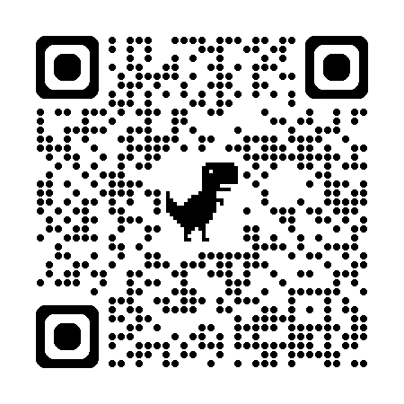
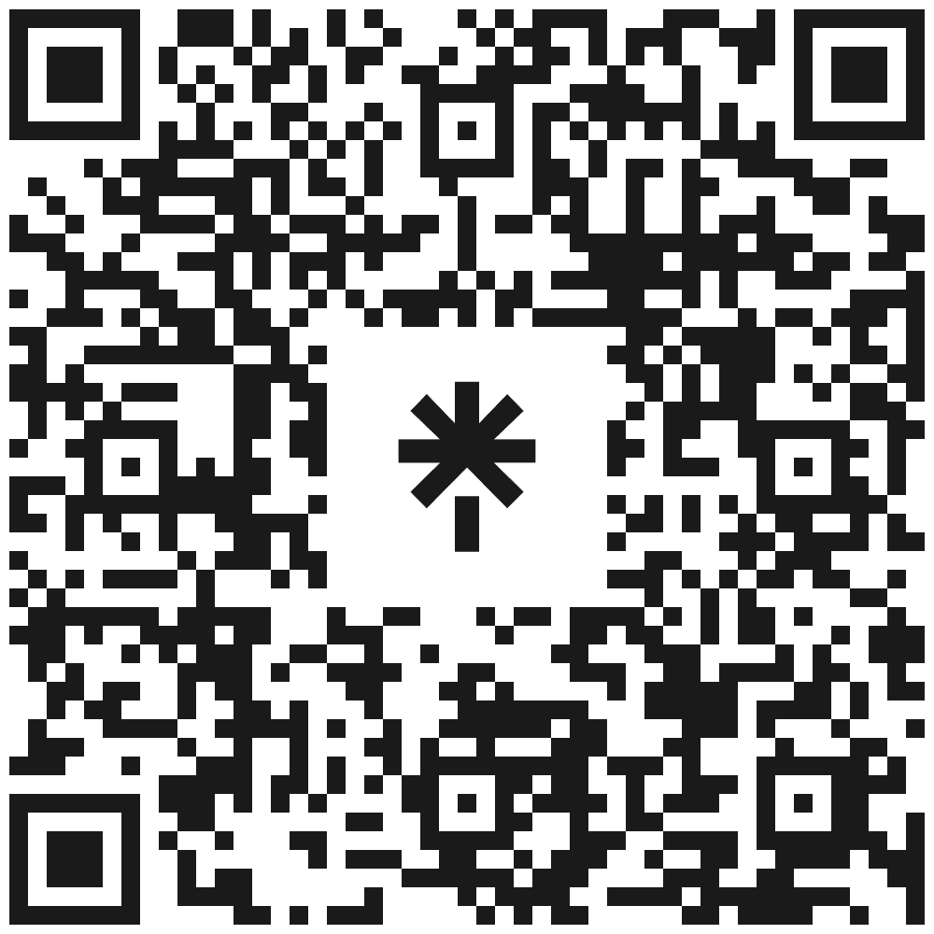
Microsoft MVP.
Client Partner at Geneca.
Spend time with family, movies, videogames, soccer.
Socials
Schedule time with me!

Slide 3
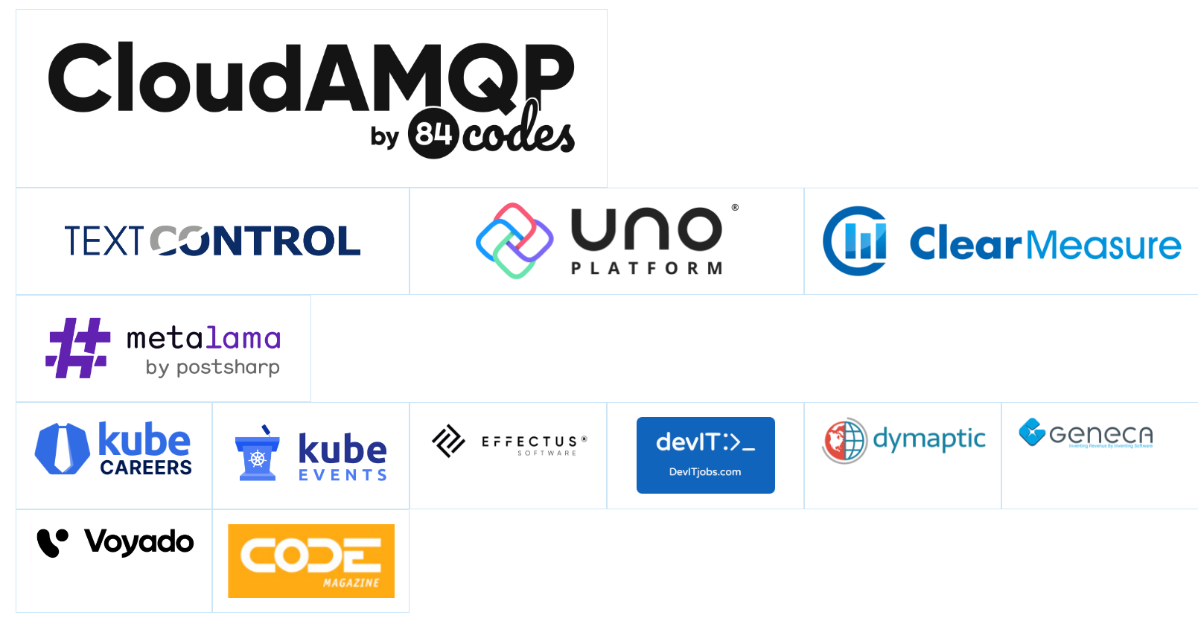
Thank You TechBash 2024 Sponsors!
Visit https://techbash.com/#Sponsors to visit our sponsors’ websites and learn more about them!

Slide 4

Agenda
Project overview.
What did we do?
Tool overview.
Lessons learned.

Slide 5

Project overview.

Slide 6

The objective.
Build a process backed by a machine learning model that maintains temperature and humidity conditions in museum spaces while minimizing energy consumption.
Notes:
Speak about the motivations: money, environment, keeping museum pieces safe

Slide 7
Why do it?
Reduce carbon footprint.
Save money.
Keep museum pieces safe.

Slide 8
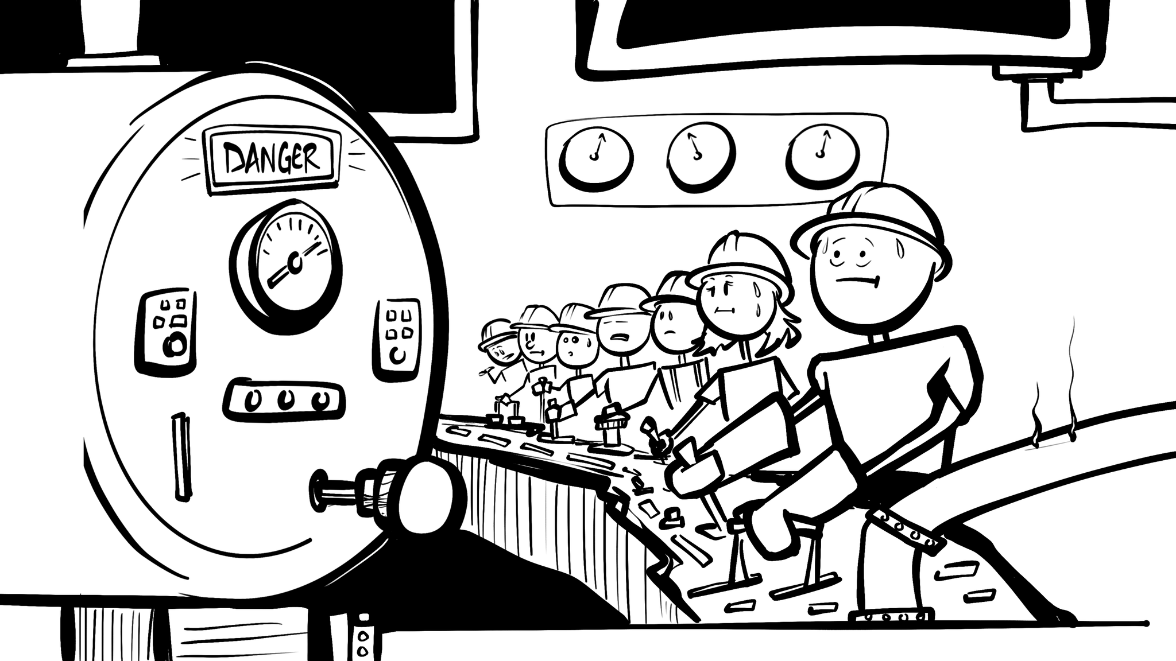
Art by @reverentgeek
Notes:
Talk about how it worked before the models: The building engineers controlling temperature

Slide 9
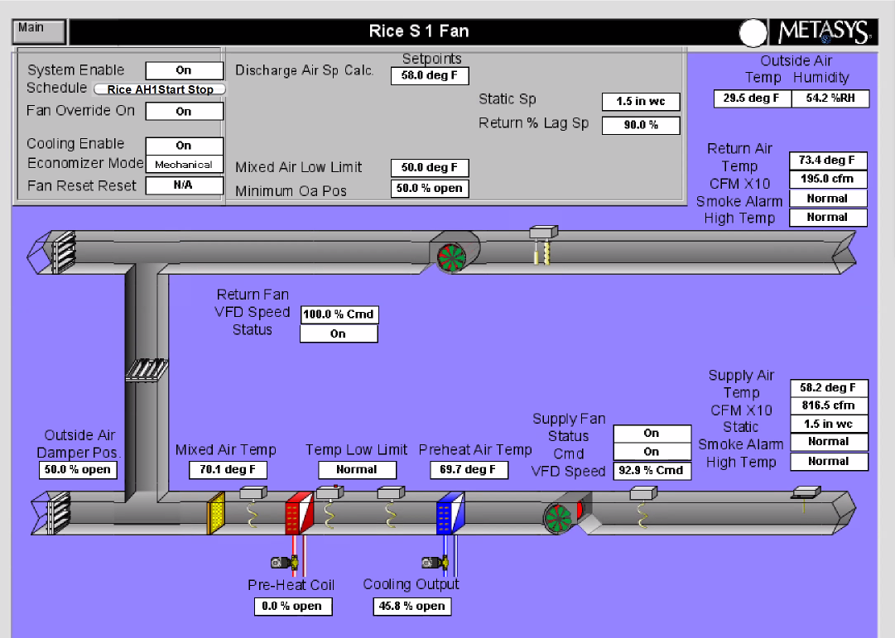
Meet the air handler.
Notes:
Heat in gallery as well

Slide 10
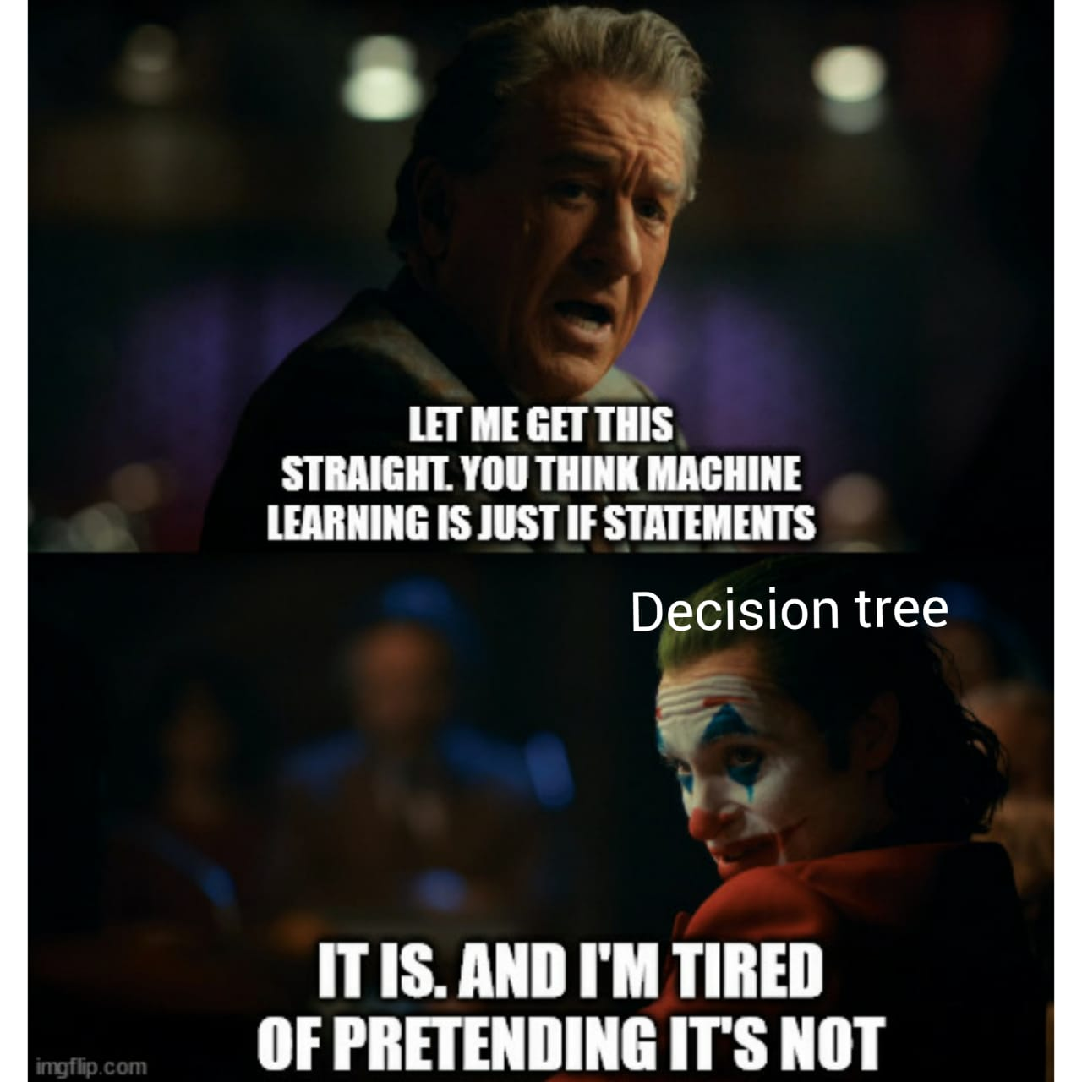

Slide 11
What did we do?

Slide 12
Evaluate existing process.

Slide 13
Improvements required.
Improved models with more features.
Separate processes for each airhandler.
Gradual temperature increase.
Improved logging.
Reporting.

Slide 14
Challenges to consider.
Data access.
Data point names not standardized.
Sensor data every 5 minutes.
Notes:
For data access, mention that we started to use AssetPlanner API

Slide 15
Improved models

Slide 16
Predicting DA-T.
DA-T
Ticket Data
OA-H
OA-T
OA-CFM
RA-T
RA-H
CO2
ZONE-HUMIDITY
SF-SPD
Month
Time
Wetbulb
Day of the week

Slide 17
Issues with predicting DA-T.
Big temperature changes.
Some features not needed.
Too conservative.

Slide 18
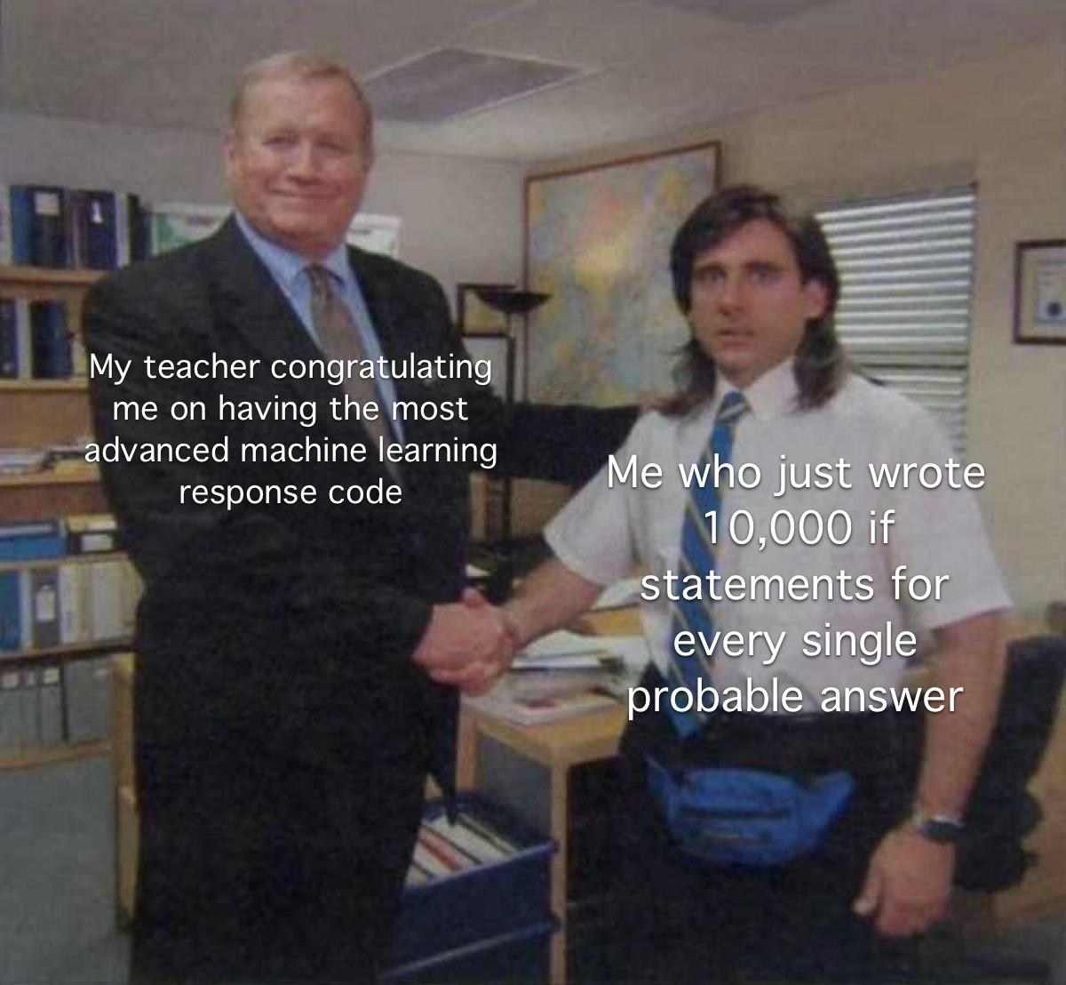

Slide 19
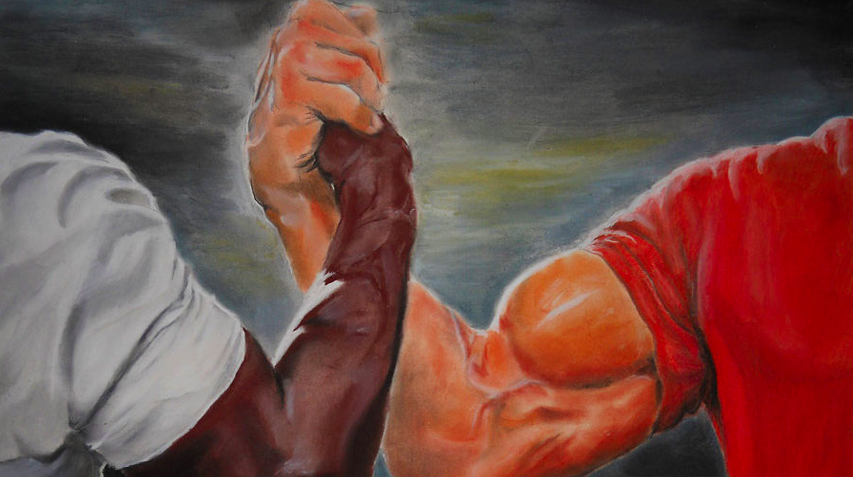
Predicting humidity.
SA-H
Humidity

Slide 20
Predicting humidity.
DA-H
RA-H
DA-T
Humidity
DA-T
CO2
Wetbulb
SF-SPD
HUM-V
RA-H
Wetbulb
SF-SPD

Slide 22
Separate processes

Slide 23
Azure functions for the win!
One Azure function per airhandler.
Specific logic per airhandler (temp and humidity threshold, calculations, etc).
Logging different conditions.
Missing data.
Warmup vs cool down.
What caused the warmup vs cool down.
Resulting DA-T.

Slide 26
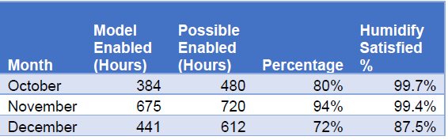
Museum 1 air handler summary.

Slide 27
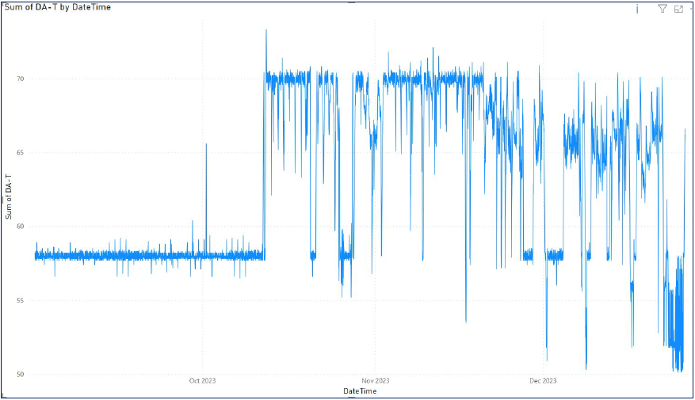
DA-T graph.

Slide 28
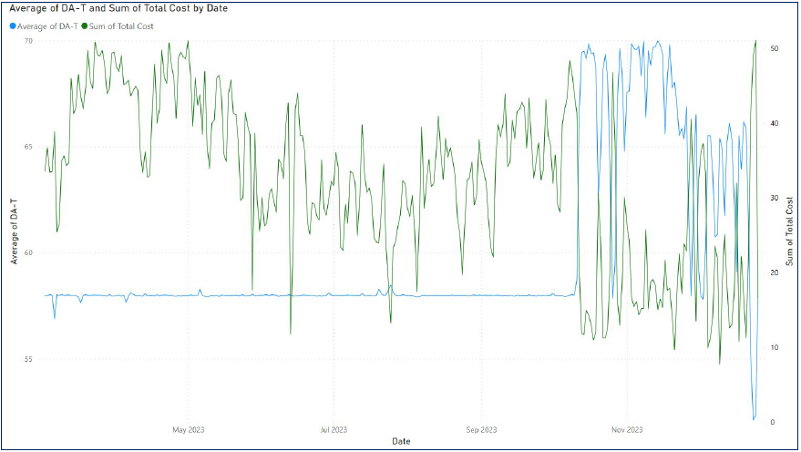
DA-T vs Total operating cost.

Slide 29
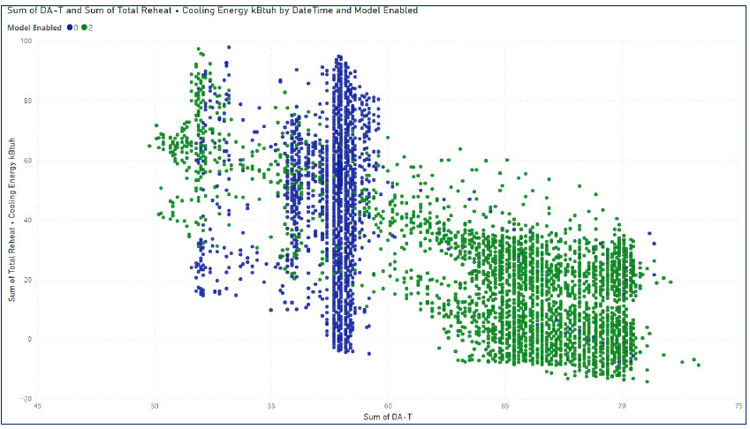
DA-T vs energy usage.

Slide 30
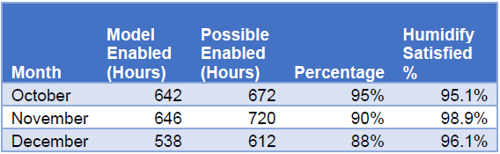
Museum 2 air handler summary.

Slide 31
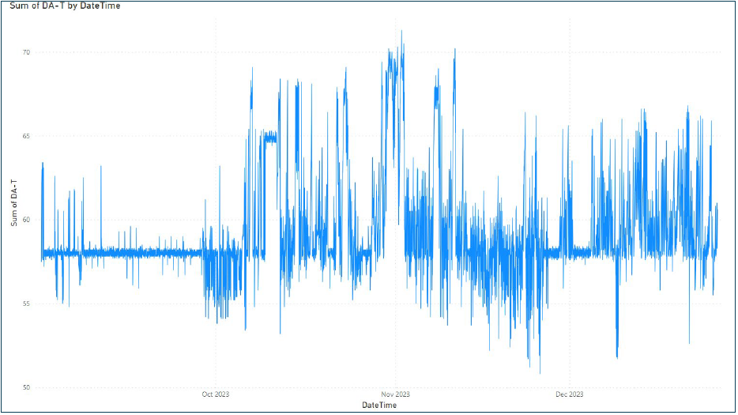
DA-T graph.

Slide 32
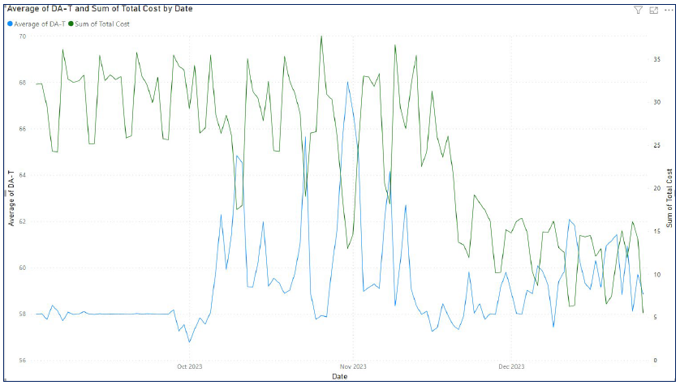
DA-T vs Total operating cost.

Slide 33
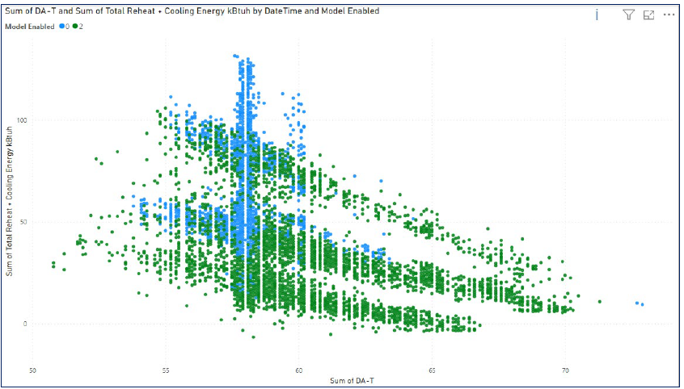
DA-T vs energy usage.

Slide 34
Tool overview

Slide 35
Azure Iot Hub

Slide 36
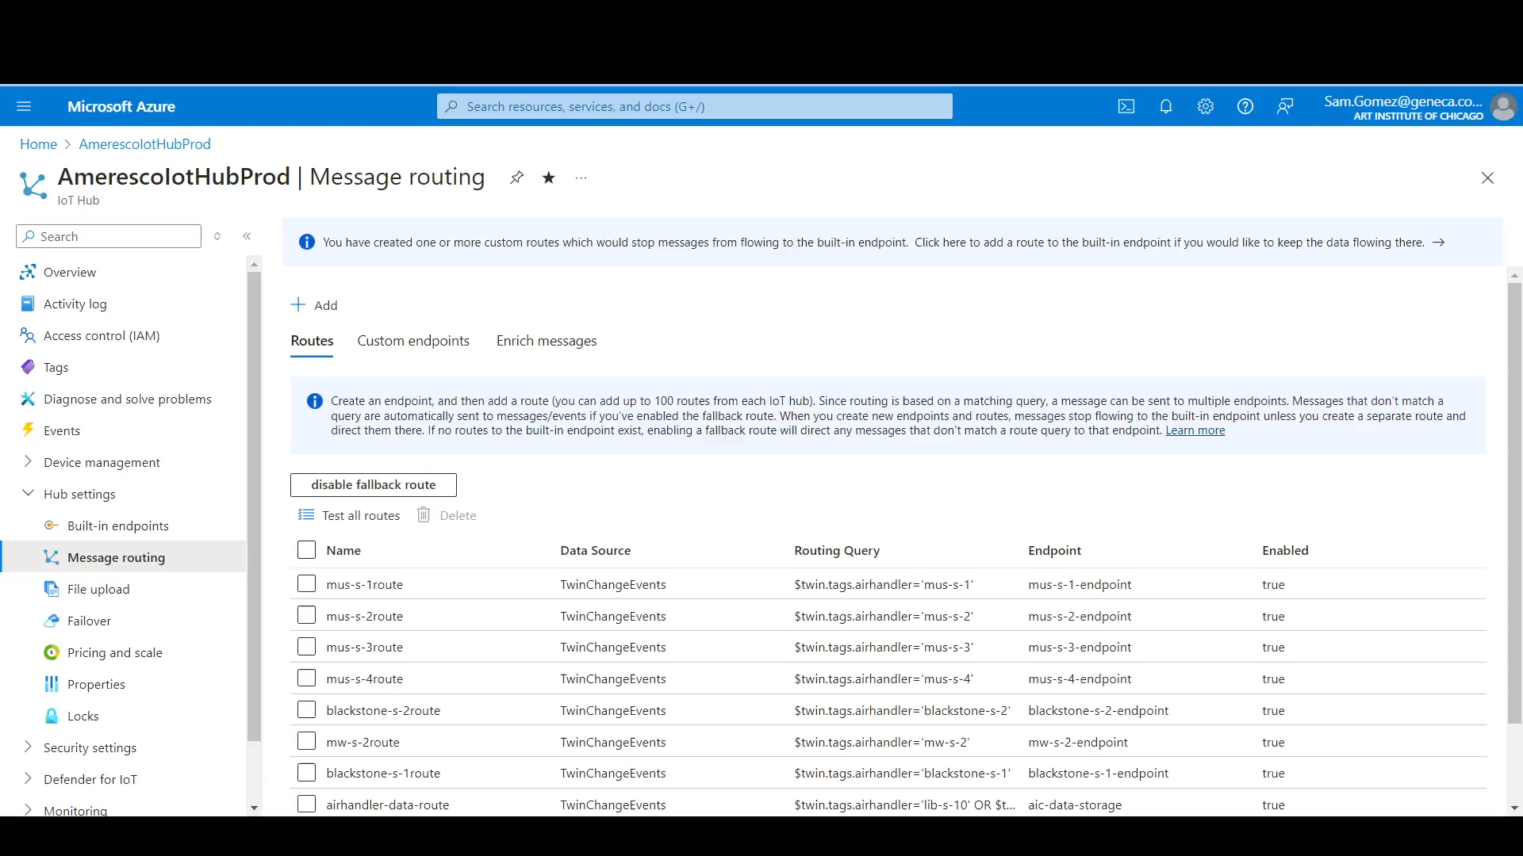

Slide 37
Azure Machine Learning Studio

Slide 38
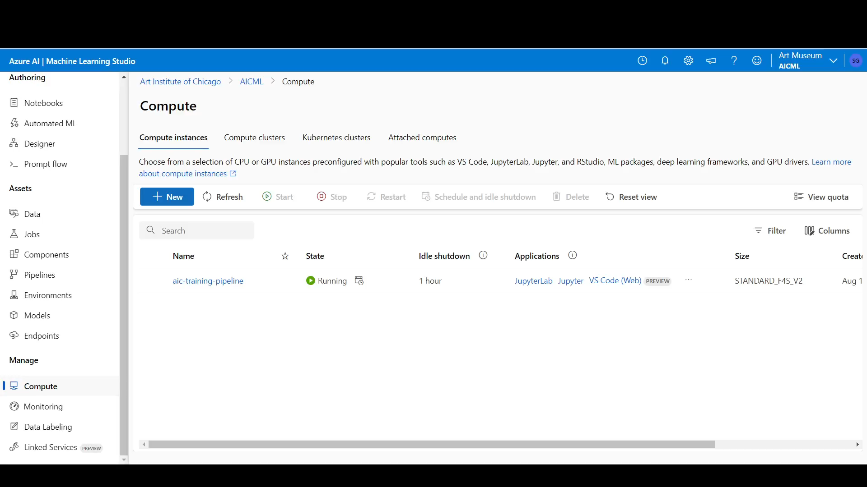

Slide 39
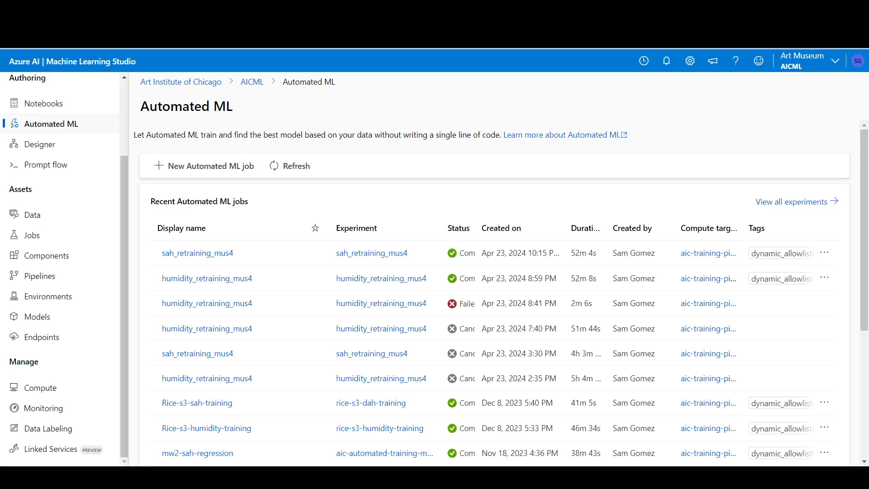

Slide 40
Microsoft Fabric

Slide 41
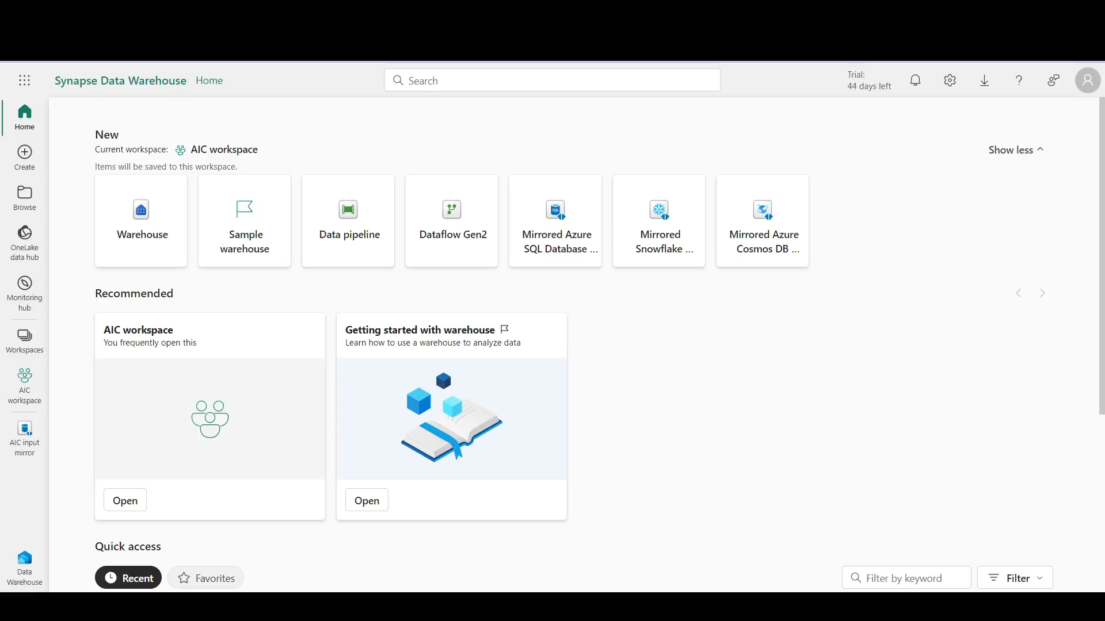

Slide 42
What did we learn?

Slide 43
Project timeline.
Data collection and cleaning (2 months).
First model training and deployment (2 weeks).
Second model training and deployment (2 weeks).
Process monitoring and refinement (4 months).
Additional process setup (1 month).
Process monitoring.
Notes:
How long did it take us to

Slide 44
Stakeholders are key.
Champion the project.
ML project deliverables vs traditional software project deliverables.
Notes:
Talk about the difference it made to have someone to champion the project

Slide 45
Define clear goals.
What is success?
“Reduce energy consumption by 5%”.
Notes:
Talk about setting specific objective (for example, 10% savings)

Slide 46
Know your data.
Accelerate development.
Faster troubleshooting.

Slide 47
Evaluate infrastructure early on.
Determine differences sooner.
1
Minimize changes down the road.
2
Identify potential gaps or issues.
3

Slide 48
Not every issue is a model issue.
Correct predictions but conditions not changing.
Data not being transferred.
Notes:
Give the examples we have found where model is doing what is supposed to but building is not responding.

Slide 49
Be responsible.
Not everyone will be excited.
Keep humans in the loop.
Apply safeguards.

Slide 50
Useful links.
https://learn.microsoft.com/en-us/azure/iot-hub/
https://learn.microsoft.com/en-us/azure/machine-learning/?view=azureml-api-2
https://learn.microsoft.com/en-us/fabric/

Slide 51
Socials
Schedule time with me!

